Slide 1
DIGITAL EXHAUSTION OF TRADE MARK RIGHTS IN THE METAVERSE
TLC, 2023
DR CESAR RAMIREZ-MONTES
LAW SCHOOL, LEEDS UNIVERSITY

Slide 2
1.BACKGROUND: INFRIGEMENT CLAIMS IN THE METAVERSE
Nike Inc v StockX (SDNY, 2022)

Slide 3
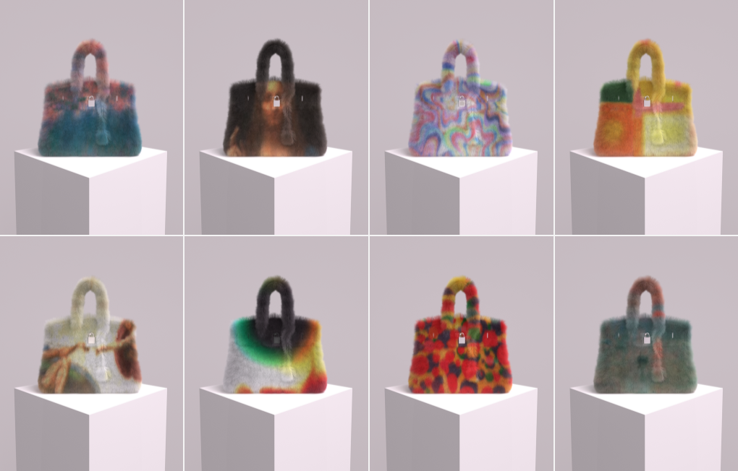
1.BACKGROUND: INFRIGEMENT CLAIMS IN THE METAVERSE (3)
Hermès v Rothchild (SDNY, 2022)

Slide 4
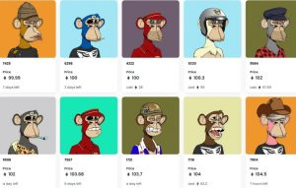
Yuga Labs v Ripps (2023)

Slide 5
2. Nike Inc v StockX (SDNY, 2022)

Slide 6
2. Nike Inc v StockX (SDNY, 2022)

Slide 7
Nike Inc v StockX (SDNY, 2022)
The manner StockX presents its Vault NFTs.

Slide 8
Nike v StockX raises several questions:
Is an NFT merely a digital receipt or claim ticket, or is it actually a good in its own right with value apart from the physical shoes?
Is the Vault NFT merely a way for the platform-reseller to use the reputation and prestige of a well-established brand to launch a new product, or is it actually a brand owner’s attempt to interfere with an innovative and efficient method to trade in current culture within a lawful secondary market for the sale of the owner’s branded goods?
Are these uses of trade marks in connection with NFTs non-infringing because they are descriptive fair/nominative uses?
Might the exhaustion doctrine provide the secondary market operator with a complete defence, or are there legitimate reasons for not displaying exhaustion?

