Slide 1
Trademark Law Institute December 1-2, 2022 Guidelines for Determining Honesty in Trademark Cases
Lotte Anemaet, PhD
Vrije Universiteit Amsterdam

Slide 2
Case C-100/02 Gerolsteiner Brunnen/Putsch ECLI:EU:C:2004:11
‘…it is for the national court to carry out an overall assessment of all the relevant circumstances. Since the case concerns bottled drinks, the circumstances to be taken into account by that court would include in particular the shape and labelling of the bottle in order to assess, more particularly, whether the producer of the drink bearing the indication of geographical origin might be regarded as unfairly competing with the proprietor of the trade mark.’ (para. 26)

Slide 3
Case C-245/02 Anheuser-Busch ECLI:EU:C:2004:717
‘…the extent to which the use of the third party’s trade name is understood by the relevant public, or at least a significant section of that public, as indicating a link between the third party’s goods and the trade-mark proprietor or a person authorized to use the trade mark, and secondly of the extent to which the third party ought to have been aware of that. Another factor to be taken into account when making the assessment is whether the trade mark concerned enjoys a certain reputation in the Member State in which it is registered and its protection is sought, from which the third party might profit in selling his goods.’ (para. 83)

Slide 4
Case C-228/03 Gillette ECLI:EU:C:2005:177
‘… In that regard, account should be taken of the overall presentation of the product marketed by the third party, particularly the circumstances in which the mark of which the third party is not the owner is displayed in that presentation, the circumstances in which a distinction is made between that mark and the mark or sign of the third party, and the effort made by that third party to ensure that consumers distinguish its products from those of which it is not the trade mark owner.’ (para. 46)

Slide 5
Court of Appeal of The Hague, 11 August 2020, IEF 19365 (Lacoste/Hema)

Slide 6
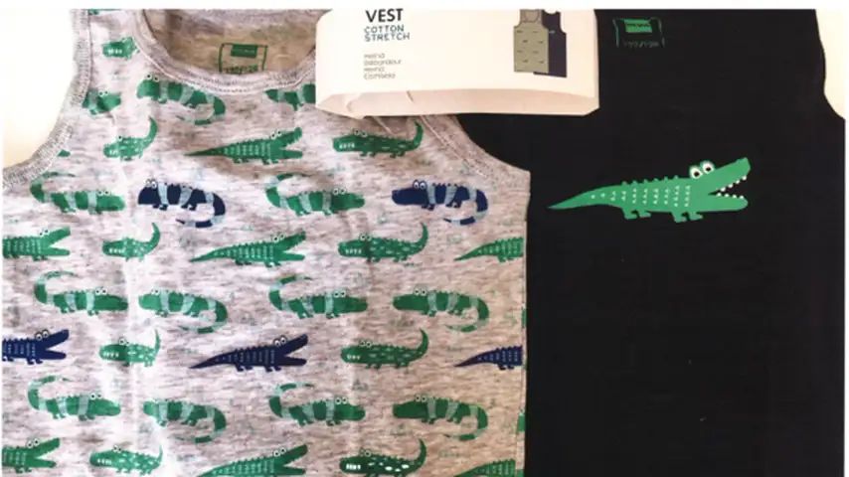
Court of Appeal of The Hague, 11 August 2020, IEF 19365 (Lacoste/Hema)

Slide 7
The End

