Slide 1
Limitations of Protection in Geographical Indications Law
from International Perspectives
Prof. Dr. Irene Calboli
Professor, Texas A&M University School of Law
Academic Fellow, University of Geneva School of Law
Hanken-Fulbright Distinguished Chair in Business and Economics
@Ire_Calboli
Irene Calboli
Irene.Calboli@gmail.com

Slide 2
International Protection for GIs
Paris Convention (1883 and following revisions)
Art. 10 and 10bis forbid any indication that could “mislead” as to the origin, source, etc.
Madrid Agreement (1891)
Still focuses on unfair competition but introduces enhanced protection for wines
Lisbon Agreement (1958)
Creates strong ad hoc protection for appellation of origin and forbids their usurpation and imitation also including “like,” “type,” etc. (few signatories)
TRIPs Agreement (Arts. 22-24) (1996)
Prohibits designations which mislead as to the true origin of a good
Enhanced protection for wines and spirits (including “kind,” “type,” etc.
Provides exceptions for generic terms and grandfathers in existing trademarks
Members agree to consider additional enhanced protection
Geneva Act of Lisbon Agreement
Tries to merge Lisbon and TRIPS

Slide 3
The Lisbon Agreement in a Nutshell
Indefinite protection in all Contracting Parties
exception: refusal, invalidation, enunciation of protection, and as long as the AO is protected in the Contracting Party of Origin
High level protection of the registered AOs in the other Lisbon countries
(against any usurpation or imitation)
Protection of registered AOs against becoming generic in the other Lisbon countries
Provides standing for taking legal action

Slide 4
TRIPS on GIs
TRIPS prescribes two levels of protection for geographical indications:
a general level of protection which requires Members to provide the legal means [sui generis or trademark protection] for interested parties to prevent the use of GIs which mislead the public as to the true geographic origin of the good, or which constitute an act of unfair competition(Article 22); and
a higher level of protection for wines and spirits which requires Members to provide the legal means for interested parties to prevent the use of GIs to identify wines and spirits that do not originate in the place indicated, whether or not the indication is misleading or accompanied by expressions such as ‘kind’, ‘type’ or ‘imitation’ (Article 23)
Notes:
Source: http://www.wto.org/English/docs_e/legal_e/27-trips_04b_e.htm

Slide 5
TRIPS: Exception to GIs Protection
The protection under Article 23 is to be read in conjunction with the exceptions under Article 24
Generic terms (“customary”) (Article 24.6)
Names of grape varieties (Article 24.6)
Prior trademark rights (Article 24.5)
Certain other prior uses (Article 24.4) (grand-father clause)
Use of personal names (Article 24.8)
No obligation to protect GIs which are not protected, ceased to be protected or fallen into disuse in their country of origin (Article 24.9)
Exceptions cannot be used to refuse to negotiate or conclude bilateral agreements aimed at improving protection of GIs (Art. 24.1 built-in agenda)

Slide 6
TRIPS: Homonymous GIs
Art. 22.4 (for all GIs)
protection against use which, though literally true, falsely represents to the public that the goods originated in another country
Art. 23.3 (homonymous of GIs for wines): no misleading test; subject to Article 22.4, coexistence subject to:
practical conditions under which the indication will be differentiated
taking into account the need to ensure equitable treatment of the producers concerned and that consumers are not misled

Slide 7
The Geneva Act
Inclusion of safeguards to:
prior trademarks rights (Art. 13.1)
personal names used in business (Art.13.2)
plant variety or animal breed denominations (Art 13.3)
generic terms (agreed statements, Rule 5.5)
Prior use as a generic in a Contracting Party is a possible ground for refusal
If the GI/AO contains a term that is considered generic in the Contracting Party of Origin, other Members are not obliged to protect such term
Opportunity for interested Parties to request the refusal of protection (Art.15)

Slide 8
Not only Alternative, but also complementary use of GI with trademarks (collective and individual marks)
CHAMPAGNE
French PDO
Different Trademarks used by different producers

Slide 9
Standing Questions: How does the International legal system for GIs translate into national/regional exceptions and limitations? What are relevant examples of current issues related to GIs that require a more robust infrastructure for exceptions and limitations?

Slide 10
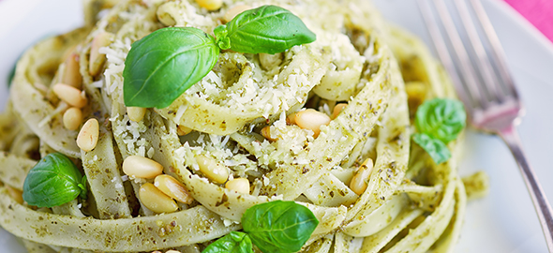
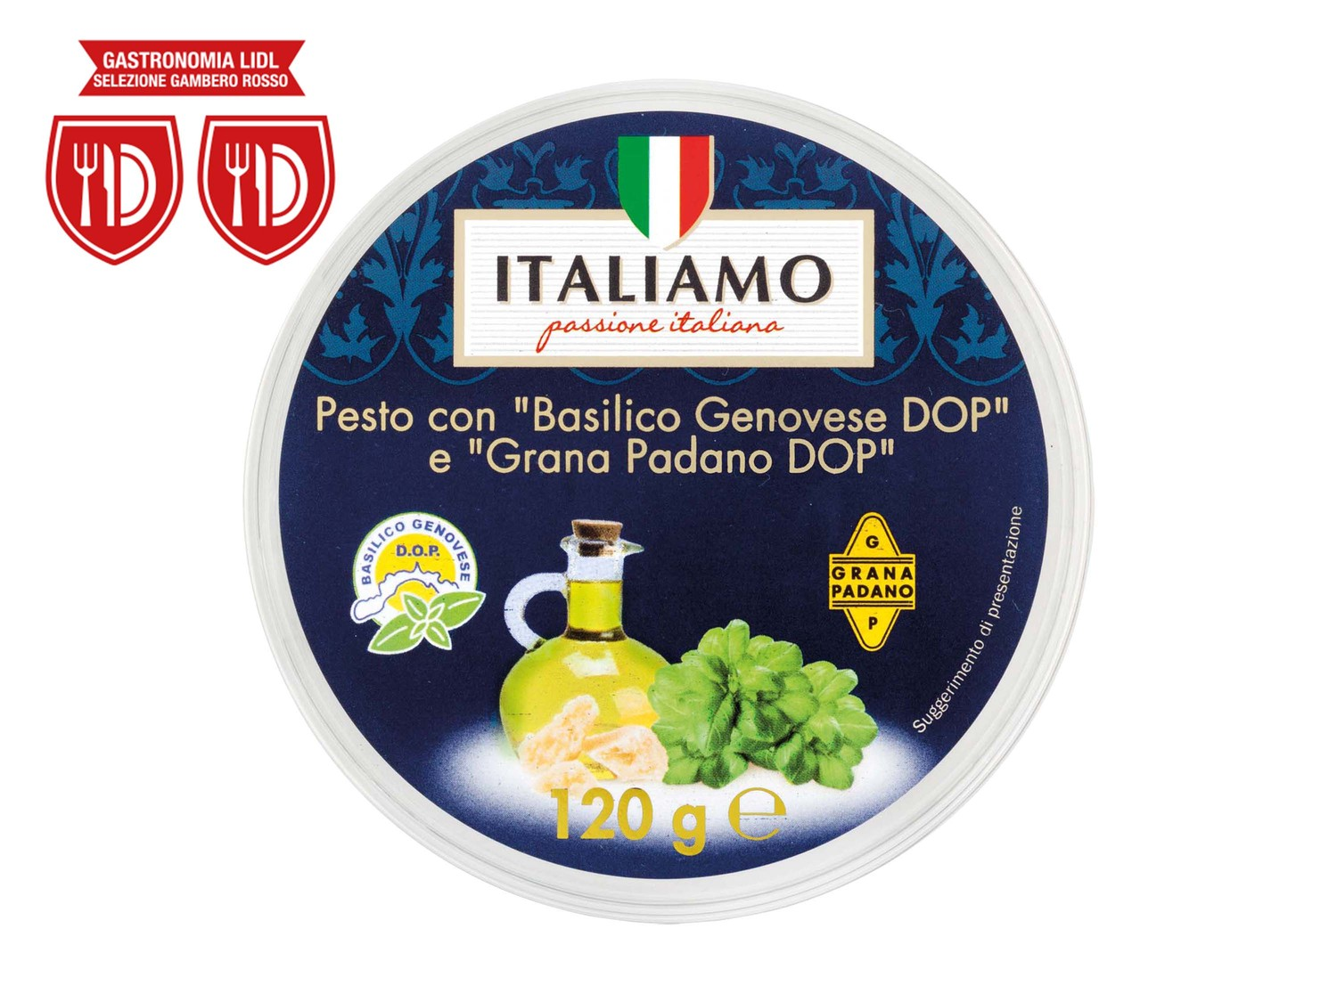
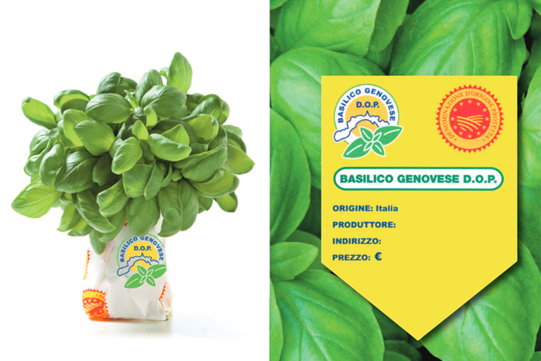
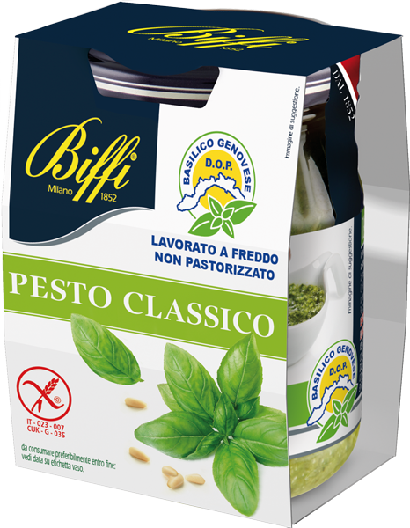
GIs as Ingredients

Slide 11
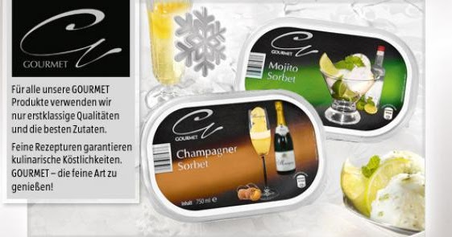

Slide 12
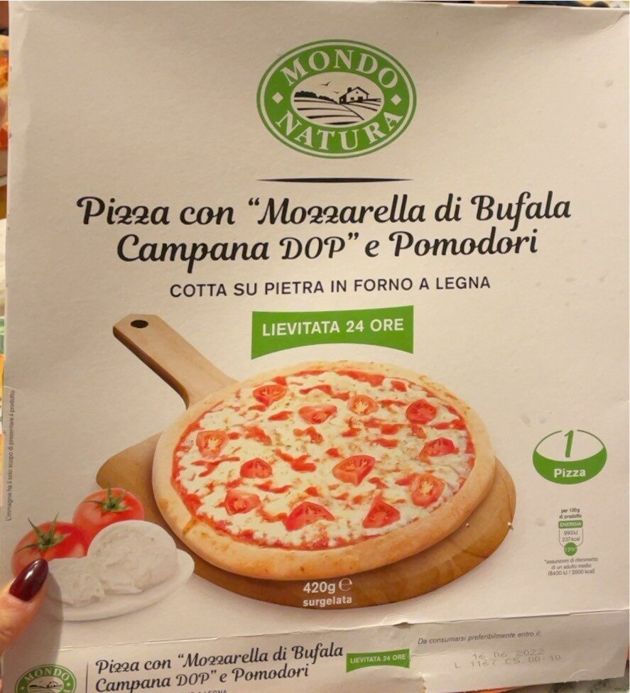
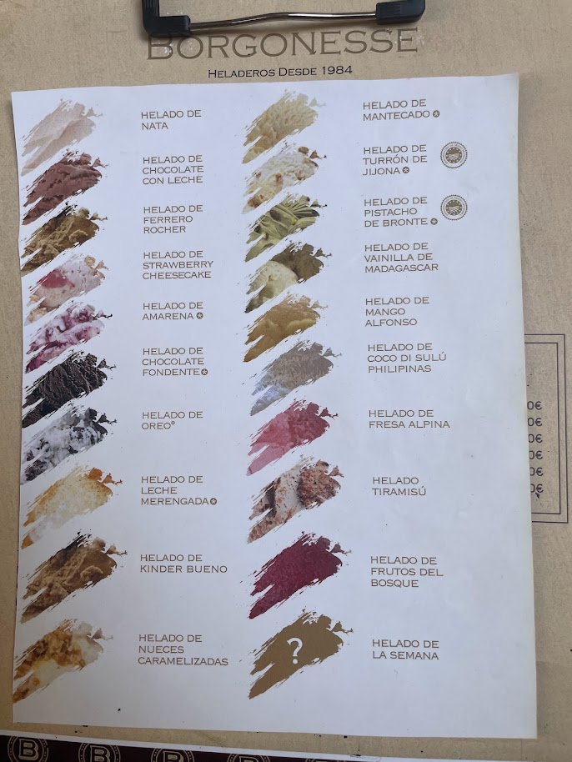
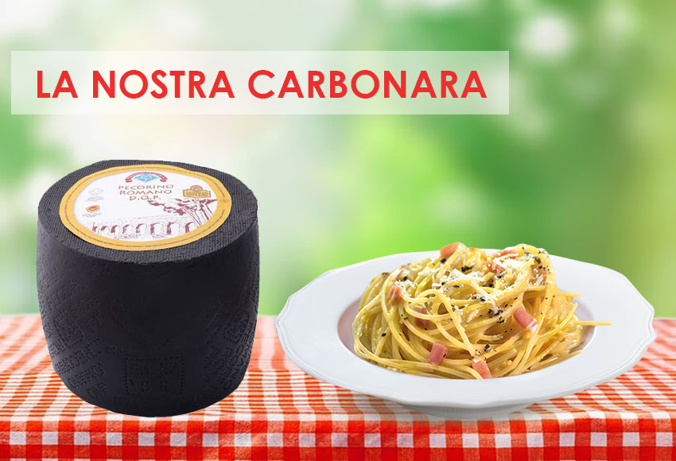

Slide 13
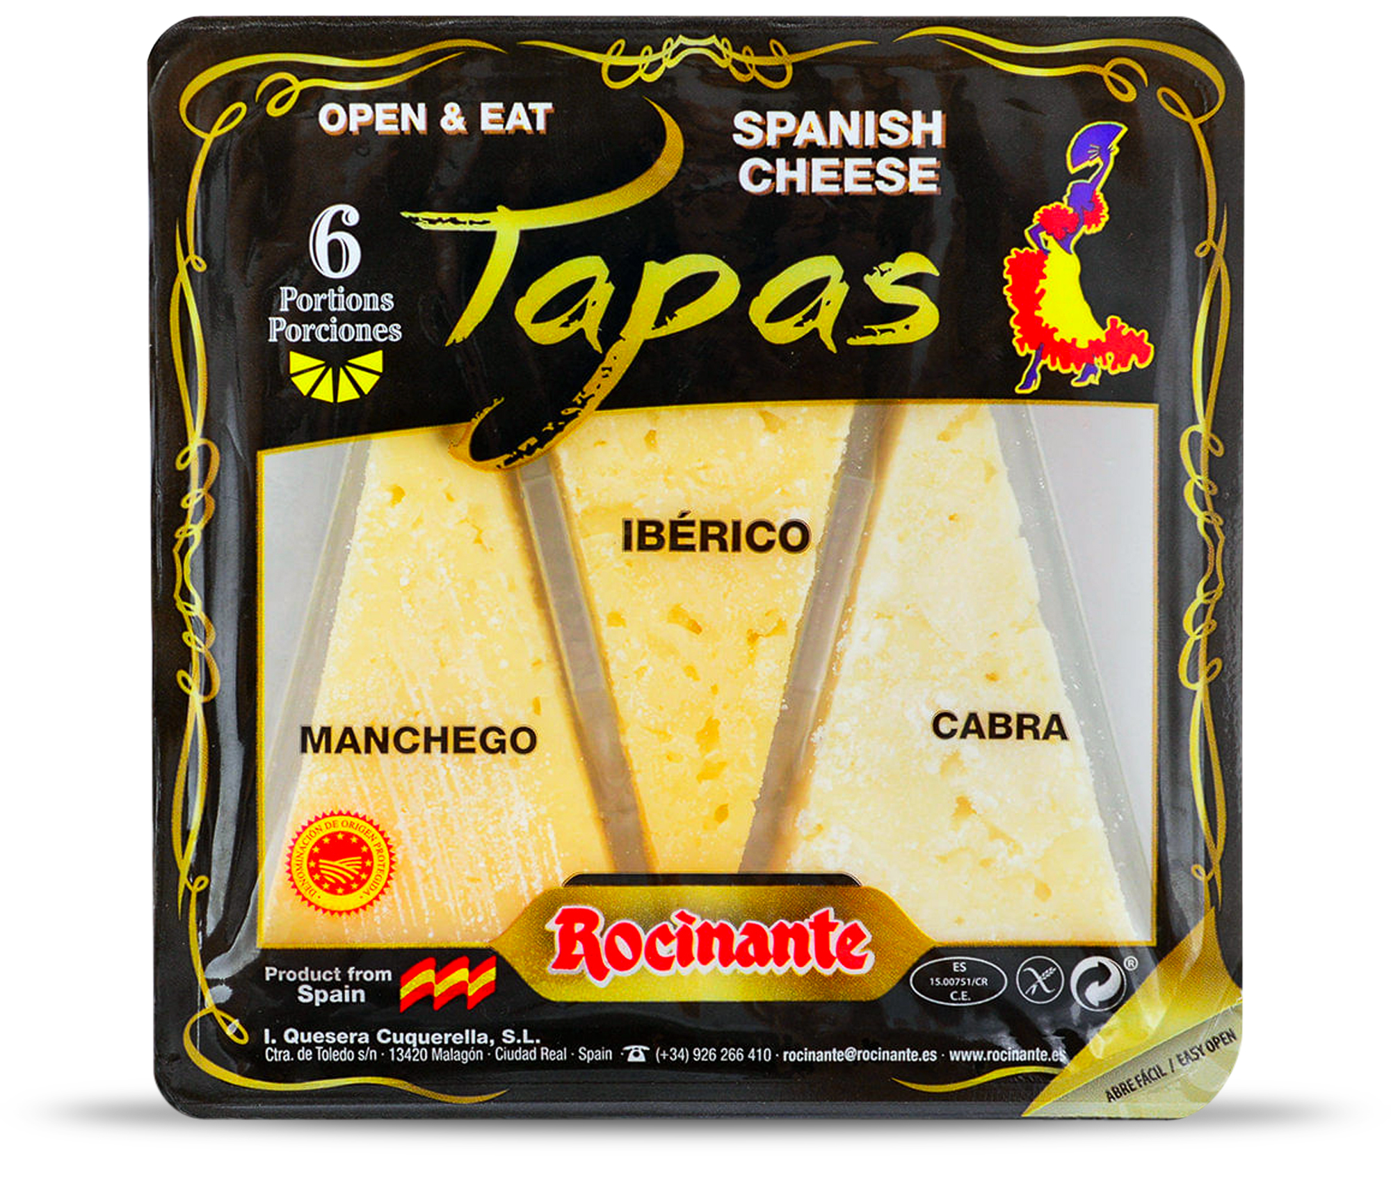

Slide 14
GIs as Ingredients
Do GI rights exhaust as do other IP rights?
What about (parallel) imports (for example outside the EU/EEA internal market)?
Issues related to GIs/trademark protection (change in the quality of the products?)
Besides exhaustion, is the use and mention of GIs (protected sui generis or via trademarks) in third party products a legitimate descriptive use?
…….

Slide 15
Thank you
@Ire_Calboli
Irene.Calboli@gmail.com
Irene Calboli

