Slide 1
Bea
TLI Conference, Referential, Descriptive and Other Fair Use of Trademarks, IViR, 1st December 2022
Parody and other forms of artistic expressions
Dr Sabine Jacques
UEA Law School & Centre for Competition Policy

Slide 2
Overview
223 cases examined (US/EUROPE and mostly France so far…)
Cases can be categorised into:
  Political, socio-economic and other public interest expressions
  Artistic expressions
  Promotion of other G&S
  Competing G&S
  Unprotected humour
Challenges ahead…

Slide 3
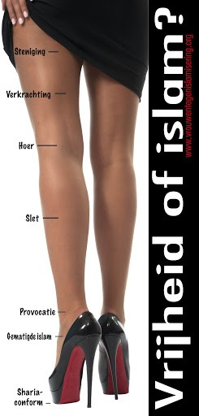
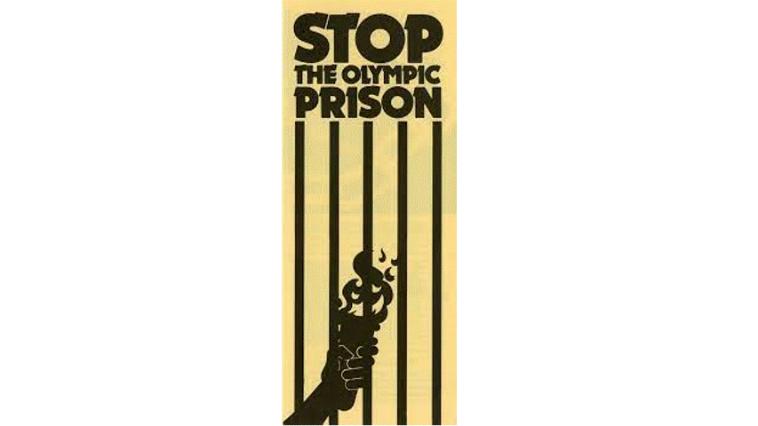
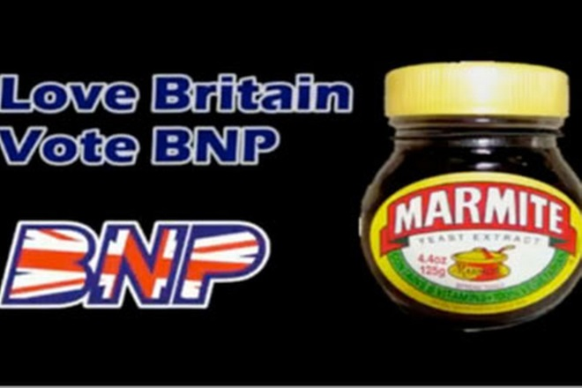
I. Political, socio-economic and other public interest expressions
US
  Absent a commercial context, use generally falls outside the material scope of TM law as the sign is used as part of a wider communicative message.
  Within a commercial context, TM infringement tests applied narrowly, slight confusion allowed.
  But ‘First amendment isn’t absolute, there is no simple mechanical rule’.
EUROPE
  Use allowed if outside a commercial context
  But TM prevails where there is a commercial aspect or harm

Slide 4
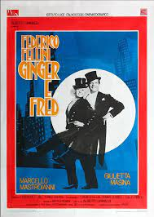
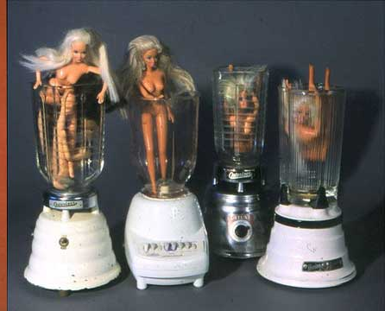
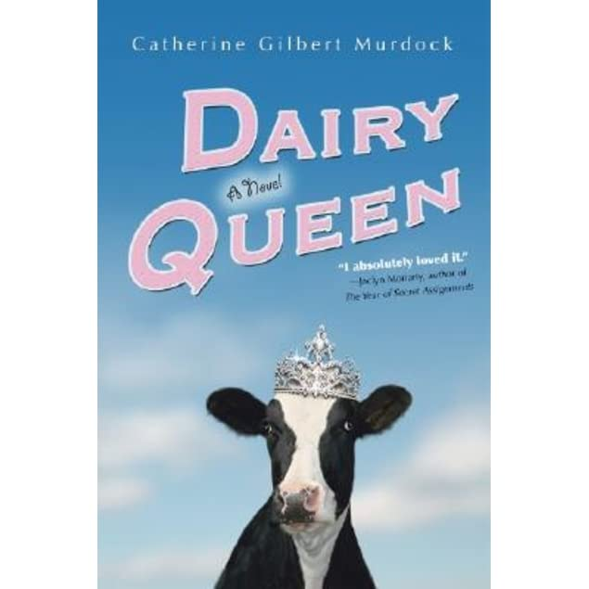
II. Artistic uses
US
  No automatic protection but increasing reliance on Rogers v. Grimaldi (1989) which sets out a two-pronged test: use not allowed if (1) there is no artistic relevance to the underlying work, or (2) explicitly misleads as to the source or content of the work.
  Other courts have applied the TM infringement tests narrowly recognising that: ‘Parody is a form of non-commercial expression if it does more than propose a commercial transaction. Artistic and parodic work is considered non-commercial speech and, therefore, not subject to a trademark dilution claim.’ Mattel, Inc. v. Walking Mountain Prods, (9th Cir. 2003)
  But not if unsavoury: Am. Dairy Queen Corp. v. New Line Prods., Inc., (1998)
EUROPE
  Greater influence of the copyright parody exception to dismiss TM claims
  Stronger sense of artistic freedom?

Slide 5
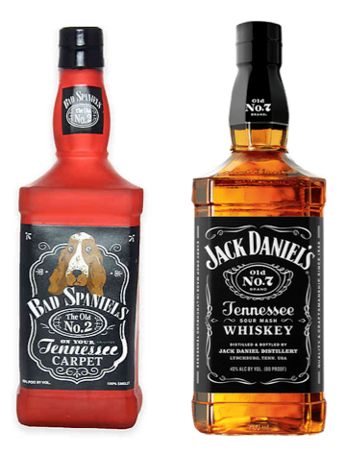
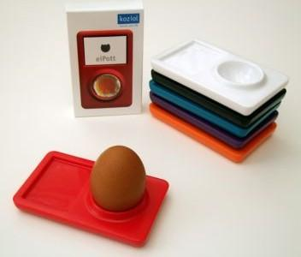
III. Promotion of other G&S
US
  Case law largely inconsistent.
  TM seems to prevail in the context of:
    TV advertising, promotion of credible other non-competing goods, trucks …
  Case law split when it comes to paraphernalia
  FoE/parody prevails in satirical/comedy show contexts and pet products but developments ahead with the possible expanded reach of Rogers outside artistic/public interest uses.
  = A defendant's claim of parody will be disregarded where the purpose of the similarity is to capitalise on a famous mark's popularity for the defendant's own commercial use.
EUROPE
- Generally TM prevails especially if the parody relates to paraphernalia (Mr Propre; Petit Chavire);
- Unless we are in a context of a satirical show (Les Guignols de l’Info 1999 & 2000).

Slide 6
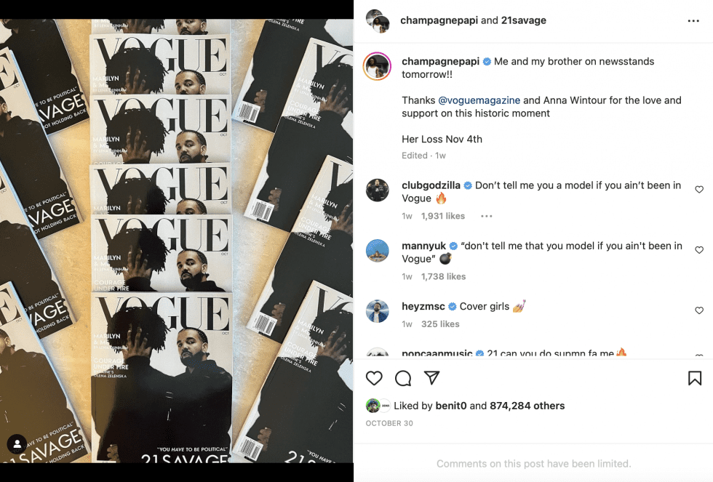
III. Promotion of other G&S
US
  Case law largely inconsistent.
  TM seems to prevail in the context of:
    TV advertising, promotion of credible other non-competing goods, trucks or any other commercial use seeking to capitalize on a mark’s popularity for the user’s own commercial goal
  Case law split when it comes to paraphernalia
  FoE/parody prevails in satirical/comedy show contexts and pet products but developments ahead with the possible expanded reach of Rogers outside artistic/public interest uses (Anheuser-Busch, Inc. v. VIP Products, LLC (E.D. Mo. 2008))
  = A defendant's claim of parody will be disregarded where the purpose of the similarity is to capitalize on a famous mark's popularity for the defendant's own commercial use.
EUROPE
- Generally TM prevails (e.g. sign for cigarette paper on sanitary pads; French cheese on CD album cover) especially if the parody is printed on T-shirts (Mr Propre; Petit Chavire) unless we are in a context of a satirical show (Les Guignols de l’Info 1999 & 2000).

Slide 7
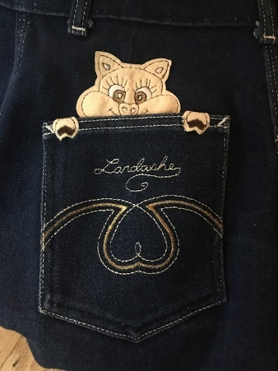
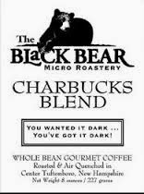
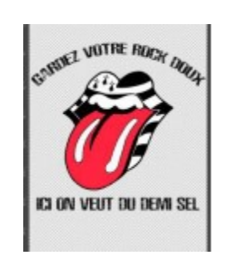
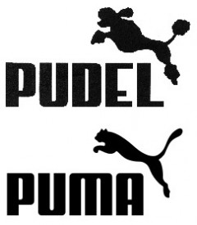
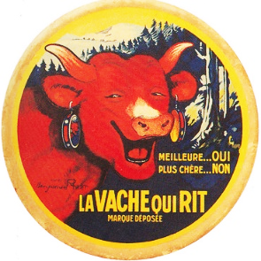
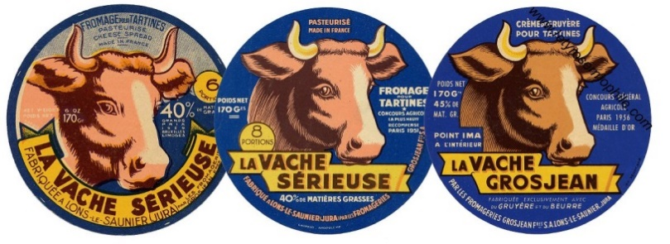
IV. Competing G&S
US
- Mostly not allowed but Jordache Ent., Inc. v. Hogg Wyld, Ltd (10th Cir. 1987) and Starbucks Corp. v Wolfe’s Borough Coffee, Inc. (2d Cir. 2013).
- Much more robust application of the TM infringement tests.
EUROPE
- Not allowed especially if imitation by contrast, limited alteration or in absence of humour but see Entrevue/Fientrecul 2012.

Slide 8
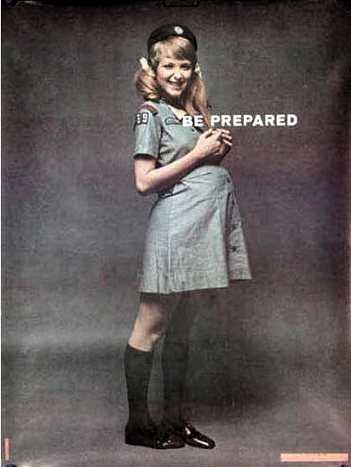
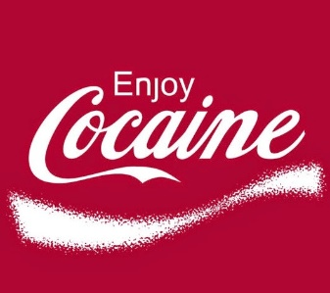
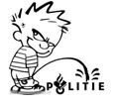
V. Unauthorised humour
Gemin
US
- Potentially offensive, defamatory, drug-related, sexually explicit of a TM generally amounts to successful dilution claim unless the association is unbelievable…
- Generally courts agree that there are alternatives available to the use to communicate the expression.
- Dilution claims will not succeed in non-commercial setting.
EUROPE
- TM prevails even if non-commercial setting and even if there is no harmful intent from the user.

Slide 9
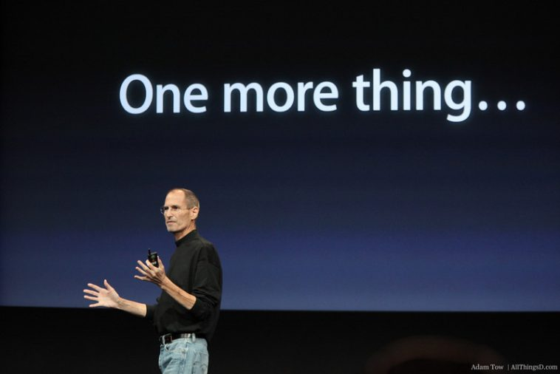

Slide 10
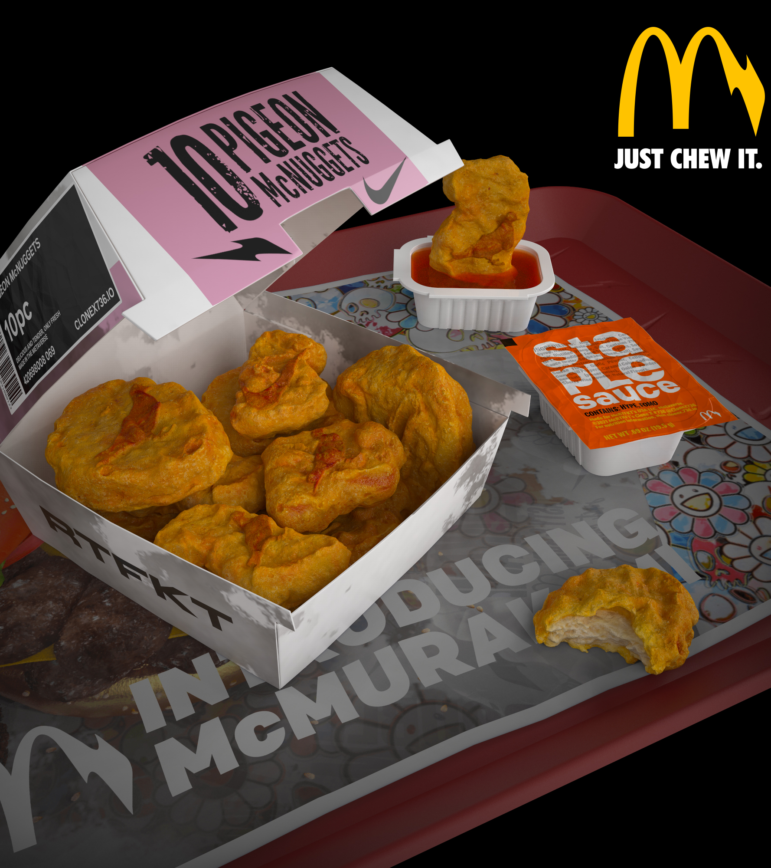
Conclusion
  US: A true intent to parody ≠ intent to confuse + when the association is essentially harmless, which merely parodies or pokes fun at the plaintiff's mark, dilution is not likely as parody tends to increase the public’s identification.
  Aim of TM law is to protect consumers and users against harmful confusion as to the source of products. TM disputes should not be about merely securing revenue streams and protect the control of brands. It should also balance this thirst against TM regime sustainability and avoid undue barriers to market entry and free commerce.
  Role of intent?
  Evidence vs average consumer threshold
  Difficulties for judges to distinguish a true parody from a use which merely intends to depreciate the G&S of the TM holder
And what about the Metaverse…?

