Slide 1
Unitary registrations and earlier unregistered rights: Comparison with US Law
Trade Mark Law Institute
March 2019
Graeme B. Dinwoodie

Slide 2
Agenda
Health Warnings on comparative use of US Trademark Law
Brief survey of leading US doctrinal mechanisms
Issues in US debate (that may or may not inform EUTM debates)

Slide 3
Comparative Use of US Trademark Law
Legal/Theoretical differences
Nature of US registration
Bare co-existence of formal state level registrations/rights in the United States
Federal supremacy (U.S. Constitution)
Mini-Lanham Acts at state level, so territorial doctrines replicate vertically
Factual differences
Greater linguistic, cultural and social homogeneity
Not only similar likely consumer/market responses, but can extend proof from one territory to entire territory with greater assurance/confidence

Slide 4
But valuable on this topic?
Sanctity of unregistered use-based rights in US makes it a prime case study
Stated Purpose of federal/EU registration
EUTM (1989): “[I]n order to open up unrestricted economic activity in the whole of the internal market . . . . legal conditions must be created which enable undertakings to adapt their activities to the scale of the Union whether in manufacturing and distributing goods or in providing services”
US S. Rep. (1946) (“Trade is no longer local, but is national . . . It would seem as if national legislation along national lines securing to the owners of trade-marks in interstate commerce definite rights should be enacted.”)

Slide 5
Registration
EUTM: “[I]n order to open up unrestricted economic activity in the whole of the internal market . . . . legal conditions must be created which enable undertakings to adapt their activities to the scale of the Union whether in manufacturing and distributing goods or in providing services”
US S. Rep. (1946) (“Trade is no longer local, but is national . . . It would seem as if national legislation along national lines securing to the owners of trade-marks in interstate commerce definite rights should be enacted.”)

Slide 6
Brief survey of leading US doctrinal mechanisms on territoriality
Priority rule involving unregistered rights (starting point for framing broader question)
Effect of federal registration:
Section 22 and Section 7(c)
Section 33(b)(5)
Remedial Limits (Dawn Donuts)
Concurrent Registrations (Section 2(d))
Cf. Max Planck Study Proposal, ¶ 3.31 (registration and use of subsequent national marks in Member State remote from the part of EU where conflicting earlier EUTM, which has been registered for at least 15 years, was used should be allowed provided later mark applied for in good faith”

Slide 7
Priority rule involving unregistered rights

Slide 8
Priority rule:
First to use has rights in area of use: Senior user can enforce rights against junior user
Tea Rose Doctrine:
Senior user cannot enjoin a good faith junior user who operates in an area that is geographically remote from the senior user.

Slide 9
United Drug v. Rectanus
1877: Regis (predecessor of United Drug) uses REX on medicinal products in Massachusetts
1883: Rectanus (and later his company) uses REX on medicinal products in Louisville
1912: lawsuit between them: United Drug wants to use, and wants Rectanus enjoined from use, in Louisville
Notes:
“Lord Diplock’s suggestion in Star Industrial that, if business is carried on in more than one country there is a separate goodwill in each country . . . . “

Slide 10
United Drug Co. v. Rectanus
“[T]he adoption of a trade-mark does not, at least in the absence of some valid legislation enacted for the purpose, project the right of protection in advance of the extension of the trade, or operate as a claim of territorial rights over areas into which it thereafter may be deemed desirable to extend the trade”
United Drug Co. v. Theodore Rectanus Co., 248 U.S. 90 (1918)

Slide 11
Mechanism for Allocating Markets?
Use in trade/“market penetration”
Registration (to follow)
(Interim) judicial innovations?

Slide 12
Zone of Natural Expansion
United Drug court left open, and some lower courts developed, the possible existence of a “zone of natural expansion” permitting the senior trademark owner to exercise rights both in the area in which it used the mark and in the zone of natural expansion.
Restatement (Third) of Unfair Competition looks upon the concept with disfavour. See Restatement (Third) of Unfair Competition §19, cmt. (c) (1995)

Slide 13
United Drug Co. v. Rectanus
“[T]he adoption of a trade-mark does not, at least in the absence of some valid legislation enacted for the purpose, project the right of protection in advance of the extension of the trade, or operate as a claim of territorial rights over areas into which it thereafter may be deemed desirable to extend the trade”
United Drug Co. v. Theodore Rectanus Co., 248 U.S. 90 (1918)

Slide 14
Effect of Registration
Lanham Act, Section 22: Registration of a mark provides constructive notice throughout the United States of the registrant’s claim
Effectively freezes junior rights (and allocates remaining territory within the United States to registrant)
But preserves good faith junior user rights: compare United Drug with Section 33(b)(5)

Slide 15
Section 33(b)(5) Defense
The mark whose use by a party is charged as an infringement was adopted without knowledge of the registrant's prior use and has been continuously used by such party . . . from a date prior to . . . the date of constructive use of the mark established pursuant to section 7(c) . . .
Provided, however, that this defense . . . shall apply only for the area in which such continuous prior use is proved

Slide 16
Dawn Donut
1922: Dawn Donut sells mixes for baked goods under mark DAWN to bakers (including New York)
1927: Dawn registers mark with PTO
1951: Hart adopts DAWN for retail baked goods in Rochester, without actual knowledge of Dawn Donuts

Slide 17
Remedial Limit (even when registrant has rights for entire territory)
Dawn Donut rule: senior registrant acquires right to enjoin junior user even when junior user adopted (after senior registration) in actual good faith in a geographically remote area
BUT CAN ONLY ENFORCE RIGHT where senior registrant shows a likelihood of expansion into the disputed territory
Application of any acquiescence claim not tested in case law (and unlikely to succeed given Dawn Donut rule and requirement of use only in the United States to maintain: no partial geographic abandonment of registered rights)
Assumption is that confusion would ensue if moved into new territory
cf. DHL v. Chronopost
cf. Enterprise v. Europcar

Slide 18
Securing Remedial Limits

Slide 19
Guthrie v. ContextMedia (CA2 2016)
“a senior user must prove a probability of confusion in order to win an injunction. But it does not follow that the injunction may extend only into areas for which the senior user has shown probability of confusion. It is not as if the senior user must prove a new claim of infringement for each geographic area in which it seeks injunctive relief. Once the senior user has proven entitlement to an injunction, the scope of the injunction should be governed by a variety of equitable factors—the principal concern ordinarily being providing the injured senior user with reasonable protection from the junior user’s infringement.”
Cf. Enterprise v. Europcar (Arnold J); most likely inconsistent with Combit (CJEU)

Slide 20
Nature of Junior Unregistered Users Rights?
Right to use the mark (i.e., defense to infringement)
Perhaps only temporarily (Dawn Donut)
Common law (unregistered) rights to exclude senior user
Right to secure registration for local rights?
State law (close to useless in US; cf. Max Planck proposal in different EU environment)
Concurrent use (federal) registration (US)
Cf. Budejovicky Budvar NP v. Anheuser-Busch Inc. [2012] EWCA (Civ) 880 (honest concurrent use)

Slide 21
Concurrent Use Registrations
Section 2(d): “[I]f the Director determines that confusion, mistake, or deception is not likely to result from the continued use by more than one person of the same or similar marks under conditions and limitations as to the mode or place of use of the marks or the goods on or in connection with which such marks are used, concurrent registrations may be issued to such persons when they have become entitled to use such marks as a result of their concurrent lawful use in commerce prior to . . . the earliest of the filing dates of the applications pending or of any registration issued . . .

Slide 22
Concurrent Use Registrations

Slide 23
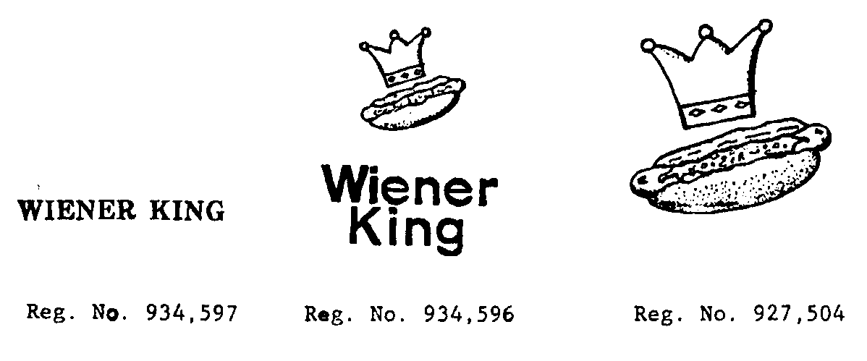
Dividing the Country

Slide 24
Issues in US debates
How small, how remote?
Use of political boundaries
Doctrinal implementation (tailoring relief or definition of “use” for acquisition of rights)
Relevance of internet and greater market integration
Resilience of doctrine despite critique both of good faith remote junior user and Dawn Donut
Paradox: greater need for such tools in crowded markets
5. Consent agreements in market allocation

Slide 25
Healthcom v. Central Arkansas AAA (2001)
Healthcom
CA
1991-92: uses CARELINK nationally; marketing in Arkansas
1992: sale of services to customer in Arkansas
January 1995: started using CARELINK mark in 6-county area in Central Arkansas
March 23, 1995: registered in Arkansas
Sept 1995: enters contract with North Arkansas hospital
May 1999: applied for federal registration (pending)

Slide 26
Other points to consider
Role of Trade Mark Law in market and social integration?
Allocating product markets and geographic markets using similar devices?
Intervening rights: cf Article 16(2)-(3) EUTMR
Case C-65/12, Leidseplein Beheer BV v. Red Bull GmbH
Does allocation of ability to preserve product market expansion raise same issues as geographic market expansion (competition, consumer choice etc.)
Compare Rosetta Stone Ltd. v. Google, Inc., 676 F.3d 144, 171–73 (4th Cir. 2012) (measure fame at time of defendant’s use) with extension of fact pattern in Hormel or Case C-125/14, Iron & Smith v. Unilever.
A first to file system with no use requirement effectively makes an initial allocation of the right to enter that market for 5 years: should these rules vary before and after 5 years?

