Slide 1
Trade Marks and Free Expression: Beyond Internal and External Balancing
Robert Burrell
Professor of Law, University of Sheffield & University of Western Australia

Slide 2
Designing new defences
Clearly an important part of bringing trade mark law back within appropriate limits
Particularly important when our policy aims require us to tolerate some degree of confusion (e.g. concurrent use defences)
Defences can help reinforce the aims of trade mark law
But they can also (i) be a fig leaf and (ii) create protected zones that extend beyond what is desirable (i.e. clear defences also create error costs)
There may be particular problems with speech defences (Burrell & Gangjee 2010)

Slide 3
Which form of balancing: A false dichotomy?
Defendants cannot be prevented from calling on constitutional principles
But routine resolution of commercial cases by reference to such principles is to be avoided: complicates litigation with little gain and impedes legislative development: Cf. McGeveran (2008)
Trade mark owners will respond in kind: Arts 17(2), 16 and 47 of the Charter
Cf. Miss World Ltd v Channel 4 [2007] ETMR 66

Slide 4
A false dichotomy?
Internal ‘balancing’ by reference to free speech principles is neither necessary nor desirable
If confusion is absent harm is not established; if confusion is present then either free speech does not provide a coherent basis for an exception or there will be a countervailing compelled speech interest
Broad understanding of compelled speech: West Virginia v Barnett 319 US 624 (1943); Wooley v Maynard 430 US 705 (1977)
cf. Lee v McArthur [2016] NICA 39 (24 October 2016)

Slide 5
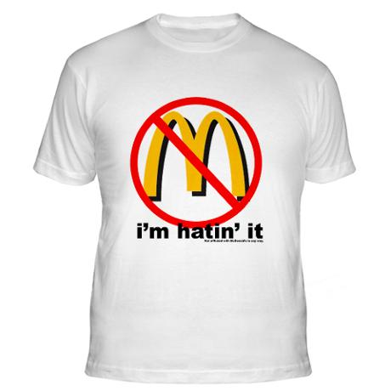
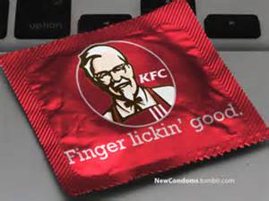
No prospect of confusion

Slide 6
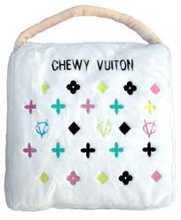
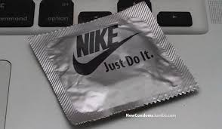
No Justification for a defence?
Louis Vuitton v Haute Diggity Dog 507 F 3d 252 (4th circuit, 2007)

Slide 7
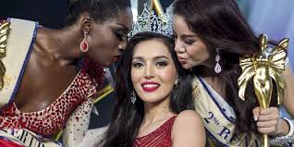
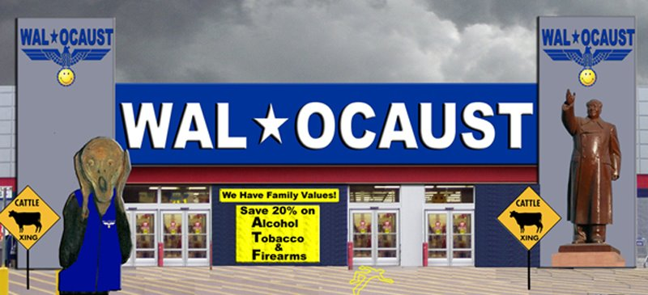
If confusion exists speech interests cut both ways
Smith v Wal-Mart Stores, Inc 537 F Supp 2d 1302 (ND Ga, 2008)

Slide 8
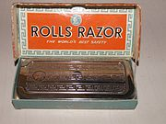
But what about dilution etc?
Morrin and Jacoby (2000) 19 J Public Policy & Marketing 265: Hyatt legal services & Hyatt hotels
Barclays Bank v Quistclose [1968] UKHL 4
Mattel Inc v MCA 296 F.3d 894 (9th Cir. 2002) twelve years on http://www.youtube.com/watch?v=hwu6NrxVVFk

Slide 9
But what about dilution etc?
What do we mean by a mark’s reputation (3 wholesome brands: Viagra, Coke and Victoria’s Secret?) (Cf. Handler 2016)
Does the negative association transfer (or stick)? (Cf. Boshoff 2016)
Free-riding: the myth of the incentivised brand creator?

