Slide 1
Functionality with a focus on application to ‘other characteristics‘
TLI workshop 2016
Amsterdam, 4./5.11.2016

Slide 2
Meaning of Art. 7(1)(e) – CJEU decisions
Art. 7(1)(e)(i):
The ground for refusal of registration set out in that provision may apply to a sign which consists exclusively of the shape of a product with one or more essential characteristics which are inherent to the generic function or functions of that product and which consumers may be looking for in the products of competitors (Hauck, para 27)
Art. 7(1)(e)(ii)
The aim is to prevent trade mark protection from granting its proprietor a monopoly on technical solutions or functional characteristics of a product which a user is likely to seek in the products of competitors (Philips, para 78)
Must be interpreted as referring only to the manner in which the goods at issue function and it does not apply to the manner in which the goods are manufactured (Kit Kat, para 57)
Art. 7(1)(e)(iii)
The ground for refusal of registration set out in that provision may apply to a sign which consists exclusively of the shape of a product with several characteristics each of which may give that product substantial value. The target public’s perception of the shape of that product is only one of the assessment criteria (such as such as the nature of the category of goods concerned, the artistic value of the shape in question, its dissimilarity from other shapes in common use on the market concerned, a substantial price difference in relation to similar products, and the development of a promotion strategy which focuses on accentuating the aesthetic characteristics of the product in question) which may be used to determine whether that ground for refusal is applicable. (Hauck, para 36, 35)

Slide 3
Objectives
1) safeguarding competition concerns (Philips, para 78)
2) delimiting the ambit of different protection regimes so as to avoid overlaps (Lego para 46; Hauck para 19, 20).
It is posited that objective (2) is not an aim in itself, but applies only insofar as it implements objective (1).
That is: harm to competition must in principle be demonstrated; no ‘automatic’ exclusion from protection of all items qualifying as designs or works (or having been protected by a patent)

Slide 4
The meaning and impact of competition concerns – proposed scheme
Starting points:
Trade mark protection is only unproblematic from a competition point of view where it does not confer on the owner a competitive advantage that does not derive from the goodwill acquired on the market (competition neutrality).
Where such advantages exist, there is reason for concern, though not necessarily for barring such signs completely from protection
The following factors are to be taken into account for measuring the gravity of concern
Separability (how closely the sign and the product are interlocked)
Substitutability (whether the sign is of limited or ‘infinite’ supply)
Attraction (how likely it is that the sign attracts consumers by its intrinsic qualities)
Whether the sign should be barred from protection or only subjected to particular hurdles should be measured according to a summary evaluation of those factors
(Additional aspects to be considered:
How to identify the `relevant market’
What about the time factor?)

Slide 5
Merchandising marks
Logos etc. of sports clubs, events, etc: Application of Art. 7(1)(e)(iii) possible (under a literal understanding), but unlikely.
Possible Arguments:
The sign is not intrinsic to the product on which it appears
Provision only targets aesthetic (not: other commercial) value
Value does not lie in the sign as such, but in its connection with a specific source
Consumers are not likely to be looking for such signs in the products of competitors (petitio principii?)

Slide 6
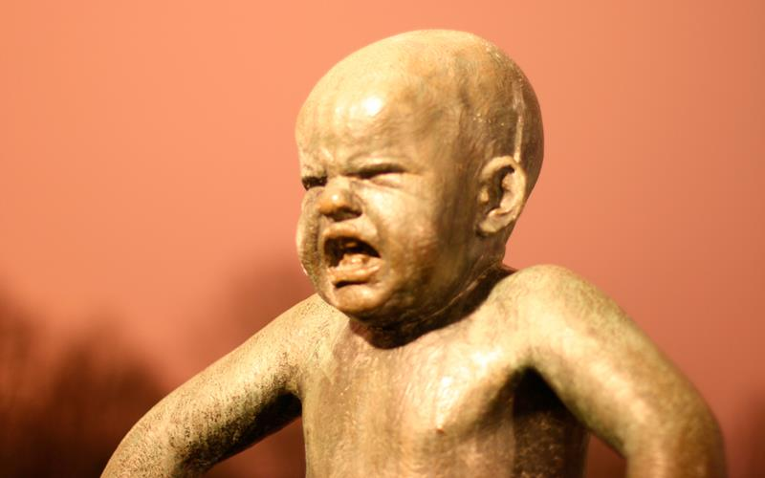
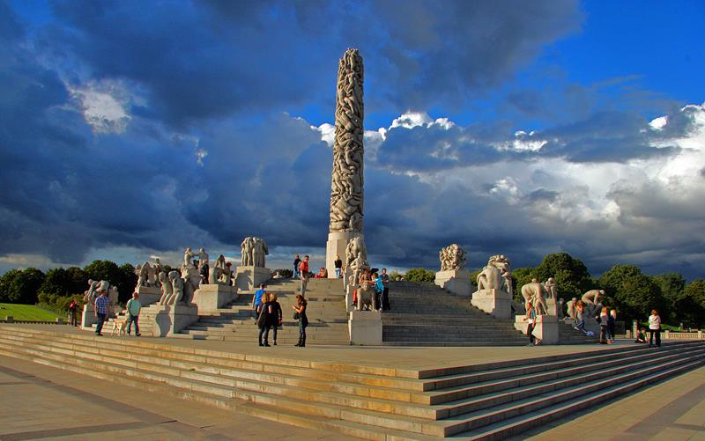
Artworks: the ‘Vigeland case‘ as example
The city of Oslo (manager of the rights of the Norwegian sculptot Gustav Vigeland) has filed for registration with the Norwegian patent Office (NIPO) several images of images of artworks created by Vigeland, which are exhibited in the famous ‘Vigelands Parken‘. The case is pending before the EFTA Court, with the questions being posed whether application for registration of the signs – at the point in time when copyright in the works expired – was filed in bad faith, or whether it clashes with public order, or would be contrary to Art. 3(1)(e)(iii) TMD 2008/95/EC.
Two examples of Vigeland‘s works:

Slide 7
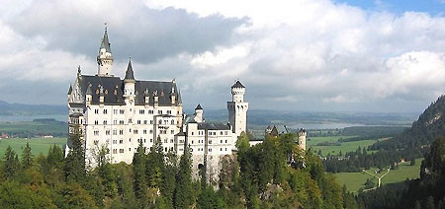
Some parallel: ‘Neuschwanstein‘
The name of the ‘fairy castle‘ built by king Louis II in the Bavarian alps was found registrable by the GCEU for a range of goods and services. National registration of the same mark had been rejected by the German Federal Supreme Court (due to lacking distinctiveness) for products typically sold as souvenirs.
Would the results be influenced by the legal amendments of TMD and EUTMR?
NEUSCHWANSTEIN

Slide 8
Own conclusions
There is every reason to be wary of trade mark registrations seeking to take control of product markets instead of just channeling goodwill gained on the market back to its source
However, instead of applying gross, ‘automatic‘ and/or provisions producing irreversible results such as Art. 7(1)(e) EUTMR, trade mark law instruments (including scope and limitations!) should be applied in a differentiated, conscious manner leaving room for case-by case-analysis
Wanted: More empirical investigation of actual problems accruing in practice!

