Slide 1
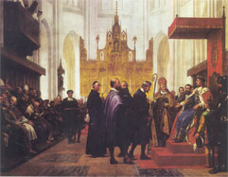
Trademarks & portrait rights, images rights, personal names, other personal indicia
Professor Thomas Riis
Centre for Information and Innovation Law

Slide 2
Conflicts between personal names etc and trademarks
Distinctiveness: Case C-404/02 (Nichols)
Many protected trademarks consist of names
2. Title to names etc.(common law rights): Prevention and limitation
Codified in Trademark Directive art. 4(4)(c): “the use of the trade
mark may be prohibited by virtue of an earlier right … and in
particular: (i) a right to a name; (ii) a right of personal portrayal; (iii) a copyright; (iv) an industrial property right”
Danish Act: + “a distinctive name of or a picture of the real
property of another party”
Limitation on the exercise of trademark rights, Directive art.
6(1)(a): “The trade mark shall not entitle the proprietor to prohibit
a third party from using, in the course of trade: (a) his own name
or address; … in accordance with honest practices in industrial
or commercial matters”

Slide 3
Suggestive mark: “Leg Godt” ≈ “Play well”
Forbes The World's Most Valuable Brands
- LEGO: No. 95 Brand value of $ 6.2 B

Slide 4
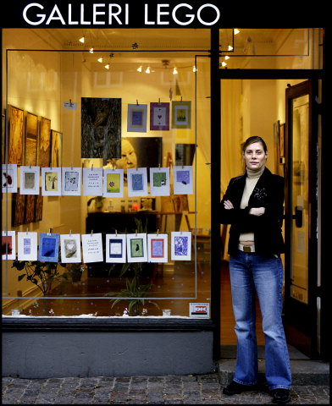
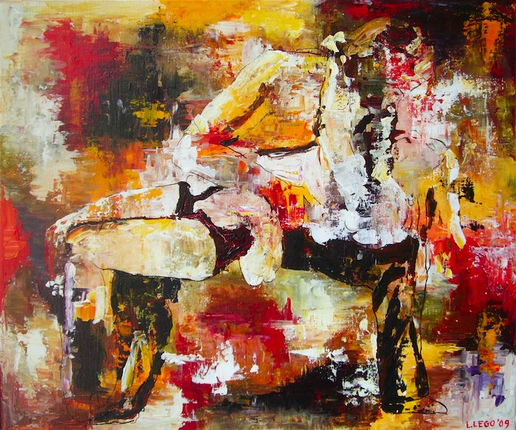
Louise Lego and her gallery
Domain names: “louiselego.dk” and “galleri-lego.dk”.
Email: louiselego@hotmail.dk
Google AdWords “Galleri Lego” and “Lego”
Meta tags: “Louise Lego” and “Lego”
Danish Trademarks Act Sect. 5(1)
“The proprietor of a trade mark right shall not be entitled to prohibit others from using, in the
course of trade and in accordance with honest practices in industrial or commercial matters,
(i) his own name and his own address …” (cf. Trademark Directive Art. 6(1))

Slide 5
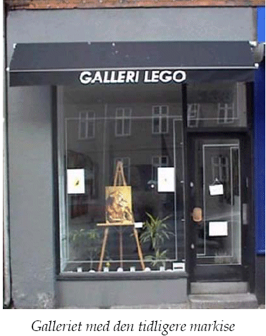

Slide 6
The Judgment (UfR 2008.372H)
Commercial and Maritime Court (Jan. 2006)
Louise Lego is entitled to use:
- Her name as signature
- ”Galleri Lego”
- ”louiselego@hotmail.dk”
Not entitled to use:
- ”Lego” as key word or meta tag
“takes unfair advantage of the repute of the LEGO mark”
Supreme Court (Nov. 2007)
”The LEGO trademark has been used extensively, it is extremely well-known and it has a high degree of distinctiveness…
The trademark is so well-known that the term GALLERI LEGO inevitably will be associated with the LEGO trademark…
Since the term GALLERI LEGO is used for products and services which only to a low degree is similar to those for which the LEGO trademark is registered, there is no real risk of confusion…
and Louise Lego is not using her name in a way that is unfair, takes unfair advantage of, or is detrimental to the LEGO trademark”

Slide 7
Complications and considerations
Are there any elements of national law?
Directive art. 6(1):
“in accordance with honest practices in industrial or commercial matters”
The scope of the right to use one’s own name as a trademark

Slide 8
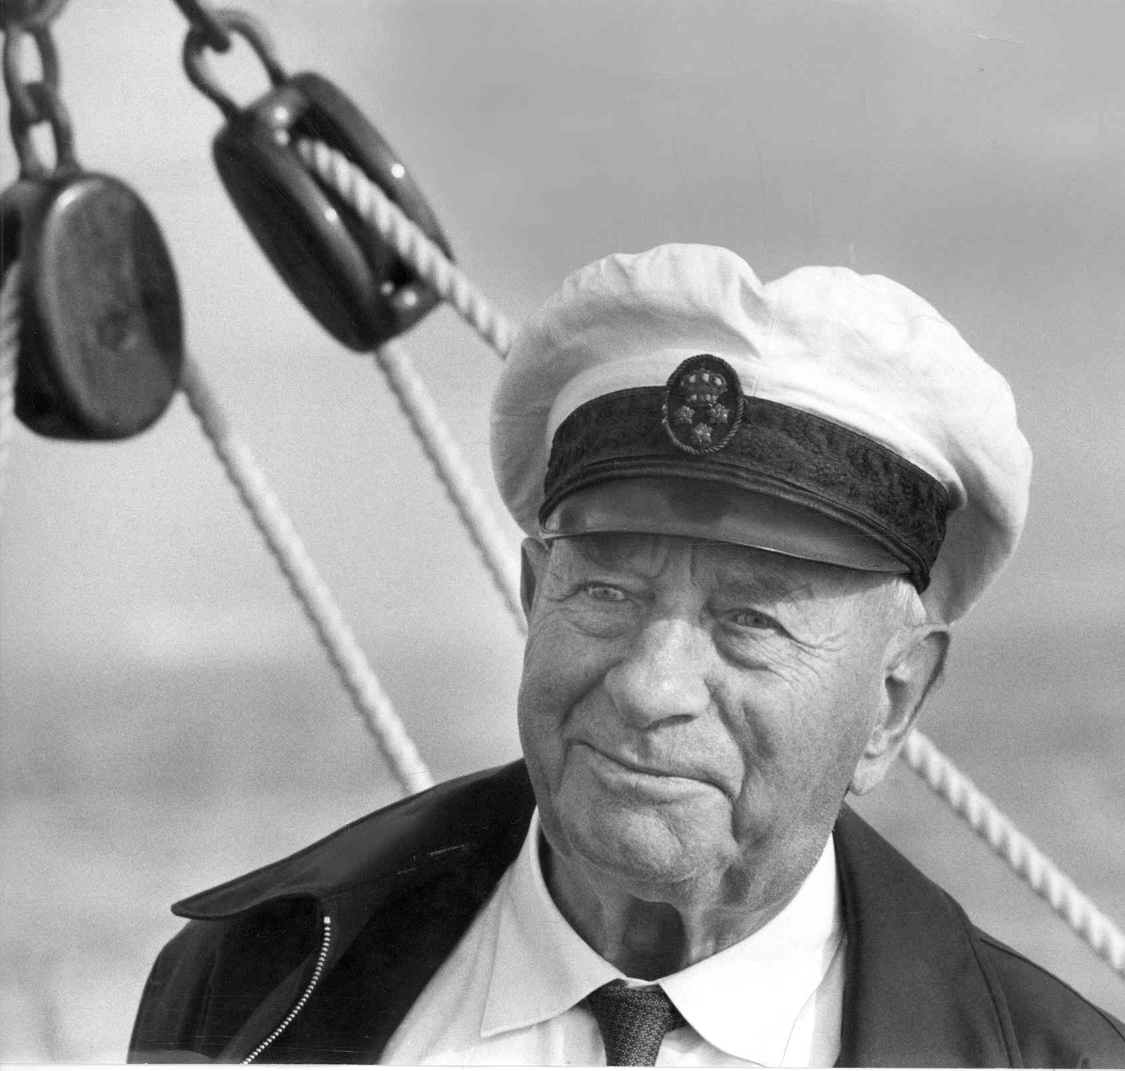
Title to personal names A.P. Møller (UfR. 1990.65/2H):
A.P. Møller Maersk A/S Anton Peter Møller (1876-1965)
The word mark AP MØLLER is registered in all classes
A bank inserted advertisement in a number of national newspapers
praising the merits of AP Møller and promoted a savings fund that the
bank had established
The subsidiary ”Rederiet A.P. Møller A/S” sued the bank for the use of
the name

Slide 9
A.P. Møller (UfR. 1990.65/2H)
No trademark rights were invoked
Supreme Court:
The company, Rederiet A.P. Møller A/S, and the (deceased) person,
A.P. Møller, is so closely related that the company is entitled to
prosecute other person’s use of the personal name A.P. Møller
On the basis of common law rights the company can prevent that
the name is used by other persons for marketing purposes
(The bank’s use of the name was furthermore not in accordance with
honest practices in industrial or commercial matters.)

Slide 10
The right to use one’s own name as a trademark: JENSEN (Supreme Court Sep. 2014)
Jensen is the most common family name i Denmark
JENSEN’S BØFHUS
[= Jensen’s steak house]
2001: 30 restaurants
Extensive marketing
JENSEN: Well-known trademark
JENSENS FISKERESTAURANT
[= Jensen’s fish restaurant]
2 restaurants
Owned by Sæby Fiskehal ApS
Sæby Fiskehal ApS’ sole owner is
Jacob Jensen

Slide 11
Conclusion and complications
Supreme Court:
”The limitation cannot be extended to the name of the owners of a
limited company, or to the names of such a company’s executives and
the like. Hence, Sæby Fiskehal is not entitled to use the name ”Jensen”
pursuant to § 5 of the Act”.
The Court disregards that Jacob Jensen has title to the name Jensen
Jacob Jensen is entitled to change the name of his limited company to
“Jensen”
Proposal for amending the Trade Mark Directive (June 2015), Art. 14(1)(a):
“The trade mark shall not entitle the proprietor to prohibit a third party from
using, in the course of trade: (a) where the third party is a natural person,
the name or address of the third party;”

Slide 12
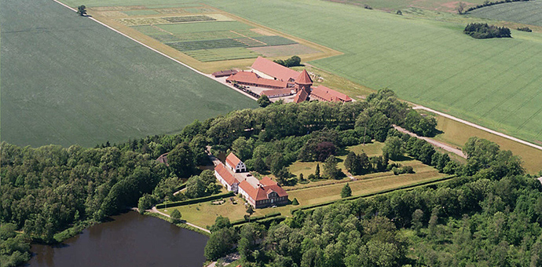
Bramstrup Estate – Title to the name of a property
Previously, a village called Bramstrup close to the estate
Activities: Farming, machine pool, property rental, agricultural research, management research, musical performances and cultural events
Word mark BRAMSTRUP in class 41 (Education, entertainment), 42 (Science and technology services), 44 (Agriculture etc.)

Slide 13
Auto mechanic
Address: Bramstrupvej 27
Nr. Kyndelse, Bramstrup
5792 Årslev
Located 1 kilometer from the Estate

Slide 14
Judgement of 26 Aug. 2015, Eastern Court of Appeals
The name:
‘Bramstrup’ is only the name of the estate
– not the name of a city or a geographical area
(despite indications in the BBR register and the fact that a small village
in Jutland is called Bramstrup)
The right:
Title to the name of the real property ”Bramstrup”
Protection per se?
Protection in relation to similar goods/services (risk of confusion)? (City Court)
‘The owner of the Bramstrup Estate has a common law right to the commercial
use of the name and can prevent others from using the name commercially
within the area that he describes as Bramstrup Estate’s “circle of acquaintances”
… no doubts that the mechanic is located within the Estate’s “circle of acquaintances”.
Hence, it is naturally to make connections between the names’
Broader than trademark protection
Limited geographical scope

Slide 15
The auto mechanic’s website Dec. 2014
The auto mechanic’s website Oct. 2015

Slide 16
