Slide 1
Registered trademarks & tort law (passing off)
Jennifer Davis
jsd27@cam.ac.uk

Slide 2
Passing Off and Unfair Competition
A British bias against regulating competition
Erven Warnink BV v J Townend & Sons (Hull) Ltd [1979] AC 731 (‘Advocaat’)
The law is applied on a case by case basis
Reckitt & Coleman Products Ltd. v Borden Inc [1990] (‘Jif Lemon’)
No apparent remedy against misappropriation

Slide 3
The elements of passing off
1. Goodwill
2. A misrepresentation
3. Damage (or in a quia timet action, the likelihood of damage)

Slide 4
1. goodwill
It is: ‘the attractive force that brings in custom’
(The Commissioners of Inland Revenue v Muller & Co’s Margarine [1901] AC 217)
It is distinguished on the market by a distinctive sign/and or get-up
It is alienable only with the underlying business
It is not the same a reputation and it is local
(Starbucks (HK) Ltd v BSB [2015] UKSC 31)

Slide 5
2. A misrepresentation
Not all are actionable: it must damage the claimant’s goodwill
(Phones 4U Ltd v Phone4u.co.uk [2007] RPC 5)
The test for confusion is empirical. Query if it differs from the test under TMD
(Marks & Spencer Plc v Interflora [2012] EWCA Civ 1501)
The type of misrepresentation recognised by the courts is open ended

Slide 6
A misrepresentation as to quality: Spalding v Gamage [1915] 85 LJ.Ch. 499HL

Slide 7
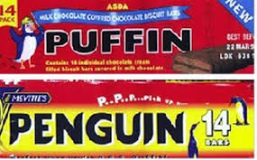
Supermarket lookalikes: United Biscuits v Asda Stores [1997] RPC 513

Slide 8
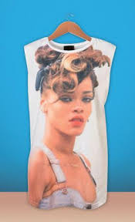
A trade connection (eg: false endorsement/ image rights?): Fenty v Arcadia Group (t/a Topshop) [2015] EWC Civ 3

Slide 9
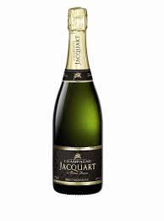
The extended form of passing off: Taittinger v Allbev Ltd [1992] FSR 647 (‘elderflower champagne’)

Slide 10
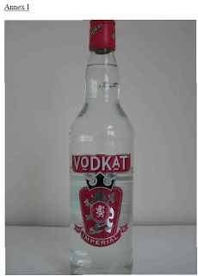
The extended form of passing off: Diageo v Intercontinental Brands Ltd [2010] EWCA Civ 920

Slide 11
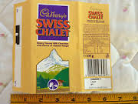
The extended form of passing off: Chocosuisse v Cadbury [1991] RPC 826

Slide 12
3. Damage
Lost sales
Lost opportunity to expand into other fields
(Lego Systems v Lego M. Lemestich Ltd. [1983] FSR 155 HC)
Damage by association
(Annabel’s (Berkley Square) v G. Schock (t/a Annabel’s Escort Agency [1972] RPC 261
Dilution & misappropriation? (‘Elderflower Champagne’)

Slide 13
Passing off and registered trade marks: overlap and divergence
A greater penumbra of protection with passing off
2. Steps in if the registered trade mark is found invalid or revoked

Slide 14
1. A greater penumbra of protection
‘Penguin/Puffin’

Slide 15
‘Jif Lemon’

Slide 16
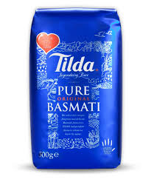
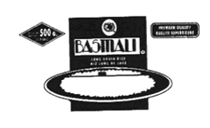
Preventing a registration because of prior right CTReg at8(4): Tilda v OHIM (Case T-136/14) GC 30/9/2015

Slide 17
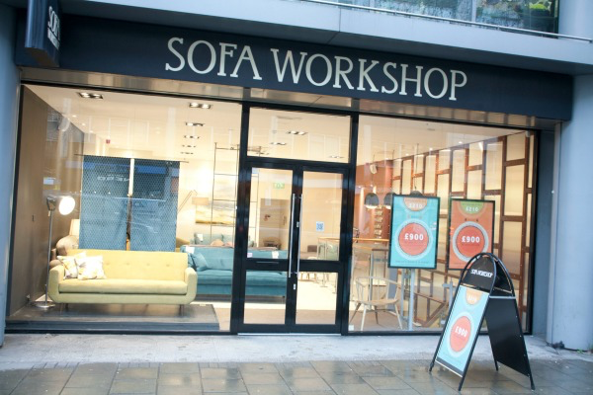
Sofa Workshop Ltd v Sofaworks Ltd [2015] EWHC 1773

Slide 18
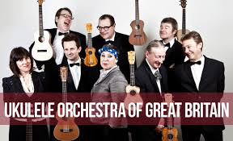
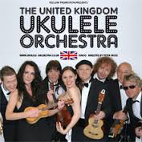
Ukulele Orchestra of GB v Clausen (t/a UK Ukulele Orchestra [2015] EWHC 1772

Slide 19
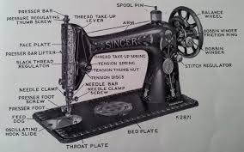
1880-2015
Passing off yesterday:
Passing off today:

