Slide 1
5th TLI SYMPOSIUM
The influence of E-commerce legislation and Unfair Trade Practices on Trademark Law
Dr. Rogier de Vrey

Slide 2
Trademark Law ↔ Unfair Competition Law
Filling in the missing pieces

Slide 3
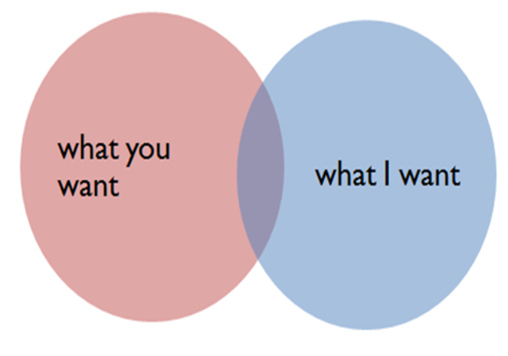
Trademark Law ↔ Unfair Competition Law
Interests covered by Trade mark and Unfair Competition law are partly overlapping:
protection of trade values and goodwill (against free rider behaviour & dilution)
Notes:
Trademark and UFC laws have much in common – overlapping interests. In many cases the same concept of the well-informed consumer.
Gut Springenheide > Case C-342/97 Lloyd Schuhfabrik Meyer [1999]

Slide 4
Trademark Law ↔ Unfair Competition Law
European trademark law does not preclude supplementary protection based on unfair competition law:
Whereas this Directive does not exclude the application to trade marks of provisions of law of the Member States other than trade mark law, such as the provisions relating to unfair competition, civil liability or consumer protection; (...)
Cf. Preamble 7 TMD and 14(2) CTMR

Slide 5
Trademark Law ↔ Unfair Competition Law
Interplay between Trademark – UC law
UC harmonisation has not been smooth
UC rules in Trademark laws
Well-know trademarks: Art. 5(2) TMD & Art. 9c CTMR
Free rider / Dilution
Honest practices (e.g. references under art. 12 CTMR)
Notes:
Unfair competition has always been something of a maverick in the development of European law (specifically in relation to IP laws). Unfair competition law (more generally: tort law) has not been harmonized in the European Union. Development of unfair competition law was specifically reserved to member states despite harmonization of IP laws, like registered trademark law. The introduction of the advertising directives, particularly comparative advertising and the unfair commercial practices directive has brought some unification, but still to a certain degree.
Max Planck Study: The concept of undistorted competition as a guiding principle for interpretation of European trade mark law.
Unfair advantage of / detriment to the repute or distinctiveness of the well-known mark (free rider/dilution). Use in accordance with honest practices in industrial or commercial matters: In particular, this is reflected in the permissibility of use to indicate the product‘s purpose, where the legitimate interests of trade mark proprietors are not adversely affected.
Trademark rules in European UC legislation: Comparative advertising: art. 4 d, f, g, (h) Directive 2006/114
Dilution, free rider, imitation, confusion (of all trademarks)
If the advertisement satisfies the criteria of article 4: no TM infringement (Recital 15 and ECJ O2/Hutchison 3G)
Recital (15): “Such use of another's trade mark, trade name or other distinguishing marks does not breach this exclusive right in cases where it complies with the conditions laid down by this Directive, the intended target being solely to distinguish between them and thus to highlight differences objectively.” If the advertisement violates the comparative advertising criteria -> trademark infringement -> enforcement directive applicable -> i.a. full reimbursement of legal costs.
Unfair commercial practices: art. 6(2) and 14 Directive 2005/29
Product marketing which creates confusion or deception > unfair

Slide 6
Trademark Law ↔ Unfair Competition Law
Trademark rules in National Unfair Competition laws:
Protection for unregistered signs (UK - passing off, continent: UC)

Slide 7
Online trademark infringements
Google France/Louis Vuitton (C-324/09) and L’Oréal / eBay (C-236 and 238/08)
Notes:
Two decisions, handed down in 2010 and 2011, have imposed some degree of unification throughout Europe: Google France SARL v. Louis Vuitton Malletier SA (on reference from the French courts) and L’Oréal SA v. eBay International AG (on reference from the U.K. courts)
The Google case did not succeed on the trademark claim, as the ECJ was not prepared to accept trademark use by Google (other than the advertisers itself). Same with Ebay.
Vicarious liability: those who profit from infringing activity when an enterprise has the right and ability to prevent the infringement (e.g. “enterprise liability” )
Contributory: someone who is not directly infringing but nevertheless is making contributions to the infringing acts of others (knowingly participates in a tortious act as jointly liable with the primary tortfeasor)

Slide 8
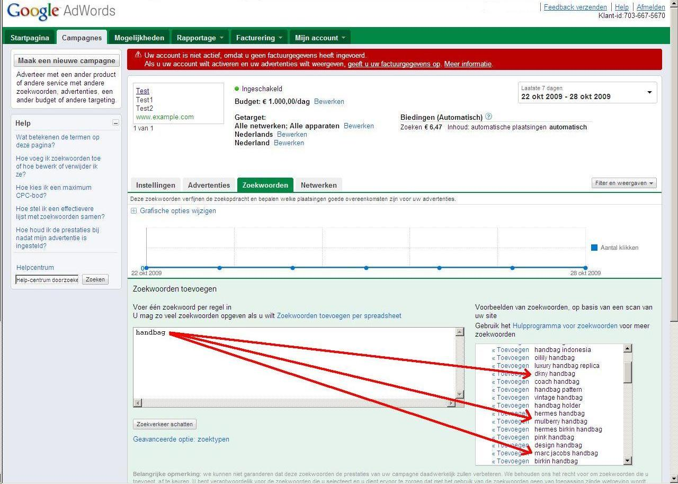
Notes:
How should the behaviour of intermediaries be judged?
How is one to assess the reasonableness of the behaviour of the intermediary given its level of specific and general knowledge of infringing activity on its site?

Slide 9
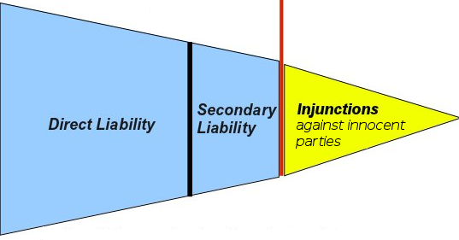
How to tackle the intermediaries issue ?
No trademark infringement by such intermediaries
Secondary liability (civil liability) / Unfair Competition law?
Art. 14 & 15 E-commerce Directive (liability > immunity)
Enforcement: Injunction
Art. 11 Enforcement Directive
© M. Husovec, Injunctions against Innocent Third Parties: The Case of Website Blocking. jipitec, Vol. 4., 2013
Notes:
The ECJ has ‘used’ Unfair Competition law / tort law, to deal with secondary liability issues

Slide 10
Civil liability as a solution?
No harmonized rules on tort law (liability)
Article 14 E-commerce directive: immunity
“Articles 12 to 15 [E-commerce directive] entitled ‘Liability of intermediary service providers’, seeks to restrict the situations in which intermediary service providers may be held liable pursuant to the applicable national law. It is therefore in the context of that national law that the conditions under which such liability arises must be sought, it being understood, however, that, by virtue of Section 4 of that directive, certain situations cannot give rise to liability on the part of intermediary service providers.”
(Google case, 107)
Notes:
Since the expiry of the period within which that directive had to be transposed, the rules of national law on the liability of such service providers must include the restrictions set out in those articles.
European law / guidance on secondary liability mostly developed in copyright case law.

Slide 11
Civil liability as a solution?
Article 14 E-commerce directive:
Not liable if:
the provider does not have actual knowledge of illegal activity; or
the provider, upon obtaining such knowledge or awareness, acts expeditiously to remove or to disable access to the information
The issue of establishing sufficient notice-and-takedown procedures is left to self-regulation (other than in the US).
Notes:
Self regulation for notice-and-takedown: the market may develop procedures and change them to adapt with development.
However, in Article 21.2 of the E-Commerce Directive it was noted that there might be a “need for additional conditions for the exemption from liability (…) in the light of technical developments,” which precludes the interpretation that the Directive was intended to leave the issue completely unregulated.

Slide 12
Civil liability as a solution?
Google case regarding operators of search engine:
Art. 14 is applicable “in the case where [the] service provider has not played an active role of such a kind as to give it knowledge of, or control over, the data stored (…) unless, having obtained knowledge of the unlawful nature of those data or of that advertiser’s activities, it failed to act expeditiously to remove or to disable access to the data concerned”
“it is necessary to examine whether the role played by that service provider is neutral, in the sense that its conduct is merely technical, automatic and passive, pointing to a lack of knowledge or control of the data which it stores.”

Slide 13
Civil liability as a solution?
Ebay case regarding operators of online marketplaces:
“The operator plays such a [active] role when it provides assistance which entails, in particular, optimising the presentation of the offers for sale in question or promoting them.”
“Where the operator of the online marketplace has not played an active role (…) the operator none the less cannot (…) rely on the exemption from liability (…) if it was aware of facts or circumstances on the basis of which a diligent economic operator should have realised that the offers for sale in question were unlawful and, in the event of it being so aware, failed to act expeditiously ”.

Slide 14
Civil liability as a solution?
Liability for online trademark infringement is not harmonized; conditions for immunity from liability are harmonised (partly)
Article 14 provides a safe harbour to intermediaries applying horizontally to trademark, unfair competition and tort claims under national law
Ceiling but no floor > legal uncertainty as to liability under national law
What is a proper Notice and Takedown-procedure?
EU: MoU as guidance?
Best Practice Guidelines? Own investigation or await notifications third parties?
Notes:
eBay also operates a ‘VeRO’ (Verified Rights Owner) programme, which is a notice and take-down system intended to provide intellectual property owners with assistance in removing infringing listings from the site. In order to participate in the VeRO programme, rights owners must complete and submit a form in respect of listings which they consider infringe their rights. They must identify each listing complained of by item number and in each case identify the reason for objecting to the listing by means of a ‘reason code’. There are 16 reason codes identifying different types of infringement. When a listing is taken down, eBay reimburses any fees paid by the seller. According to the information set out in the order for reference, more than 18 000 right owners participate in the VeRO programme. L’Oréal has declined to participate in the programme as it contends that the programme is inadequate.
EU Memorandum of Understanding on the Sale of Counterfeit Goods via the Internet, May 4, 2011

Slide 15
Injunction q.q. ?
Article 11 of the Enforcement Directive:
“(…) Member States shall (…) ensure that rightholders are in a position to apply for an injunction against intermediaries whose services are used by a third party to infringe an intellectual property right, without prejudice to Article 8(3) of [the European Copyright Directive]”
Ebay case: against operators of online marketplaces to end infringements and prevent future infringements:
“Those injunctions must be effective, proportionate, dissuasive and must not create barriers to legitimate trade”
Notes:
Inspired by the German Störerhaftung doctrine, related to the prevention of future infringements: obligations extended only to infringements that were essentially of the same character.

Slide 16
Injunction q.q. ?
Commission report on the application of the Enforcement Directive (COM (2010) 1589 final):
“Injunctions against intermediaries are not intended as a penalty against them, but are simply based on the fact that such intermediaries (e.g., Internet service providers) are in certain cases in the best position to stop or to prevent an infringement (…)
The aim (…) is that injunctive relief can be granted against the intermediary irrespective whether there has been a determination of liability of the intermediary or the third party. Other than these provisions, third party liability has been left to the legal system of each Member State.”
Irrespective of fault, safe harbour > because they are “in the middle” ?
Intermediaries are the “lowest cost avoider”
Notes:
The Commission makes clear that interlocutory injunctions must be available against “intermediaries,” irrespective of fault, when their services are used to distribute “counterfeit goods,” and that they cannot rely on “absolute immunity” when “intellectual property rights” are infringed.
Are intermediaries potentially subject to injunctions or liability because they are “in the middle,” or because they “contribute to, or facilitate, infringement?”

Slide 17
Limit: no general monitoring obligation
So: general obligation to monitor?
No: L’Óreal, and SABAM (C-360/10), Scarlet (C-70/10) and UPC/Constantin (C-314/12) [8(3) Infosoc]
Art. 15 E-commerce directive: No general obligation to monitor
Proportionality
Fundamental rights to have “freedom to conduct a business” and “freedom of speech”

Slide 18
First website blocking order for TM infringement
High Court UK: Cartier / ISPs,17 October 2014 (Mr. Justice Arnold)
Richemont vs main ISPs
Looks at art. 8(3) of the Infosoc Directive (section 97A of the 1988 Act)
Thresholds for jurisdiction:
Intermediaries?
Infringement by operators websites?
Do operators use services ISP to infringe?
Access providers not exercising any control are also “intermediaries”, Case C-557/07 (Tele 2)
Also providers of users that access infringing sites, Case C-314/12 (UPC Telekabel Wien)
Do ISPs have ‘actual knowledge’?
Emails from Richemont and evidence in support of application
Notes:
Art. 8(3) has been implemented, but art. 11 Enforcement Directive did not require implementation according to Parliament
Intermediaries: Yes
Infringement by operators websites: Yes
Do operators use services ISP to infringe?
Both service and access providers, even without exercising any control. Case C-557/07 LSG-Gesellschaft zur Wahrnehmung von Leistungsschutzrechten GmbH v Tele2 Telecommunication GmbH
Both providers with contractual relations to the person who infringed a copyright or related right and providers of users that access infringing sites, Case C-314/12 UPC Telekabel Wien GmbH v Constantin Film Verleih GmbH
Do ISPs have ‘actual knowledge’?
Not a requirement under art. 11 ED, but in the view of Justice Arnold absence of actual knowledge would be tantamount to a general obligation to monitor

Slide 19
First website blocking order for TM infringement
Proportionality
comparative importance of the rights ↔ justifications for interfering with those rights
TM rights vs freedom to carry on business and receive information
availability of alternative measures which are less onerous
Action against operators, Notice & takedown, Payment freezing, Domain name seizure, De-indexing, Customs seizure
efficacy of the measures to be taken by the ISPs
CoA The Hague, 28 January 2014 (Ziggo/Brein): not proportional
ECJ UPC/Constatin (balance of rights)
costs of implementing the measures
Application/updates: right holder, implementation: ISP (higher subscription charges)
dissuasiveness of those measures
impact on lawful internet users

Slide 20
First website blocking order for TM infringement
Safeguards
Operators websites, ISPs and their subscribers can apply to court
More information on blocked website
Sunset clause of 2 year (suggested)
Application for order: Reimbursement legal costs under art. 14?
Notes:
[own question] Is an injunction against an intermediary based on art. 11 Enforcement Directive, enforcing IP rights against infringers, such as reimbursement of legal costs under art. 14? "borne by the unsuccessful party“. Dutch Ziggo/Brein case, art. 14 was applied.
Order can be granted ex parte but "national procedural rules must provide a possibility for internet users to assert their rights before the court once the implementing measures taken by the internet service provider are known" (UPC v Constantin)
Interests: why no notice & takedown?
Don't view the (financial) impact of injunctions on ISPs on a case by case basis

Slide 21
Questions
Conclusion
ISPs have benefited from legislative safe harbours – but tread carefully: no (general) actions of direct or indirect infringement against ISPs, absent clear evidence of fault
If infrastructure ISP benefits society and ISP reasonably cooperates with right holders, it should enjoy safe harbour
Art. 11 Injunctions may well lead to increased price of internet access
New tools: establishing the prerequisites for indirect infringement and tailored appropriate remedies
Right holders pooling resources, unifying notice-and-takedown procedures (with enforcement bodies).
Notes:
ISPs have benefited from legislative safe harbors are today extremely successful, powerful, and wealthy enterprises. However, wealth and success alone are not grounds for increasing liability
Result of injunctions: increased price of internet access or it is theoretically possible to see injunctions against innocent third parties being issued only on the promise that right holders will pay the implementation costs.
This scenario, however, is not explicitly envisaged by the Enforcement Directive and of course is not appealing to the right holders.
The question of injunctions in Europe is becoming more important than liability in tort, especially because existing safe harbours set forth in Articles 12 to 14 of the E-commerce Directive protect intermediaries from additional costs possibly incurred by expansion of secondary liability doctrines, but do not protect them from costs resulting from these sort of injunctions. Outcome depends on the level of resistance from the intermediaries.
Injunctions Justified? Vulnerable to abuse, great potential to stifle innovation > derailing future of the Internet. If so, we need to create more checks and balances in the IP system of rights and enforcement.

